Slide 1
CMSC 411 Performance (Cont…), Benchmarks, and Performance Pitfalls
Ergun Simsek
Fall 2022 - Lecture 3

Slide 2

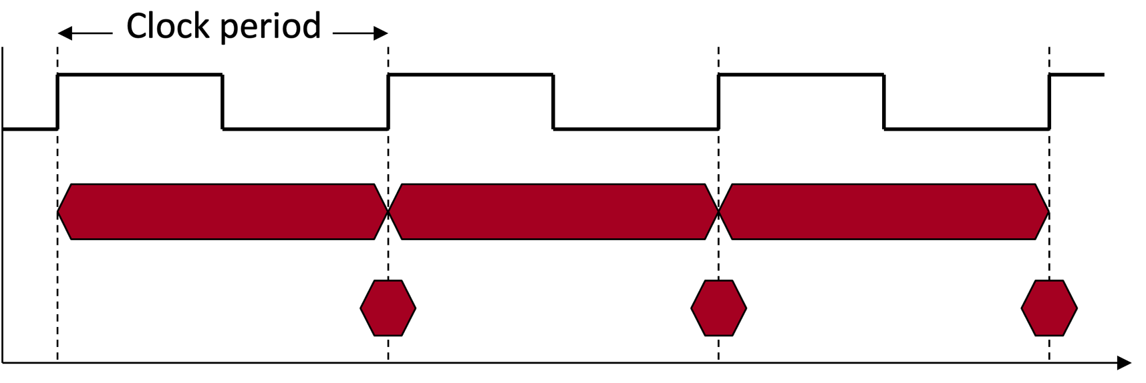
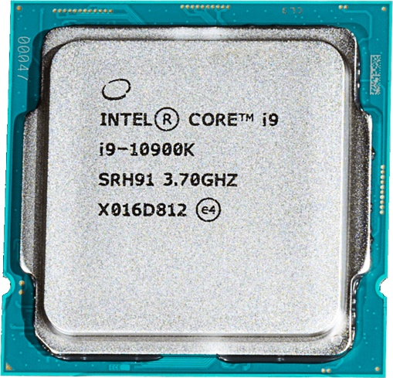
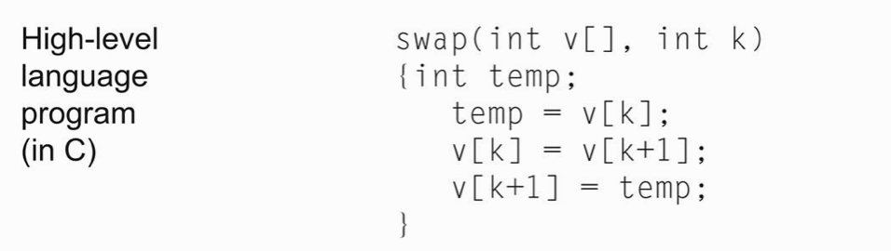
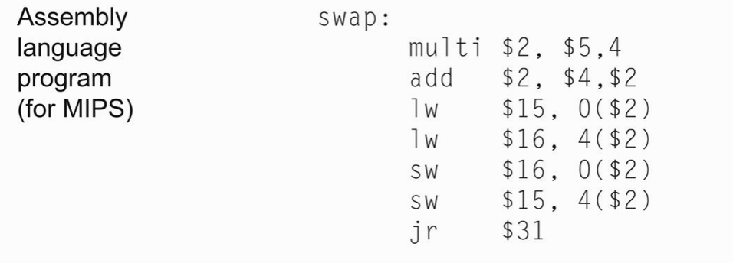
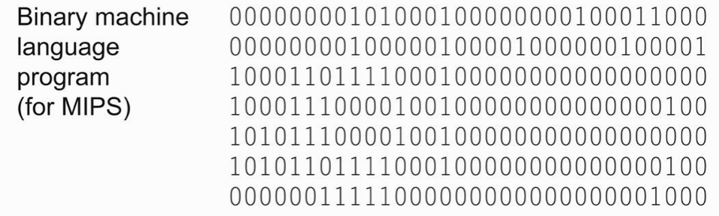
Last Week
Tunnel
Compiler
Assembler

Slide 3
Instruction Count and CPI
Last week, we said that we always want to improve the performance
Instruction Count for a program
Determined by
Program
Instruction set architecture (ISA)
Compiler
Average cycles per instruction (“CPI”)
Determined by CPU hardware
If different instructions have different CPI
Average CPI affected by instruction mix

Slide 4
Program Clock Cycles
Instead of reporting execution time in seconds, we often use clock cycle counts
Why? A newer generation of the same processor…
Often has the same cycle counts for the same program
But often has different clock speed (ex, 1 GHz changes to 1.5 GHz)

Slide 5
Instruction Count and CPI
Some operations (e.g., division) require longer time to execute
Longer time = A higher number of cycles
CPI: Average number of cycles per instruction

Slide 6
CPI Examples
PDP-11, VAX, Intel 8086: CPI > 1
Load/Store RISC machines CPI = 1
MIPS, SPARC, PowerPC, miniMIPS
Modern CPUs CPI < 1
Pentium4 0.33
Xeon 0.25
M2 ?

Slide 7
How to Improve Performance?
Many ways to write the same equations:
So, to improve performance (everything else being equal) you can either
________ the # of required cycles for a program;
________ the clock cycle time or, said another way,
________ the clock rate;
________ the CPI (average clocks per instruction).
Decrease
Decrease
Increase
Decrease

Slide 8
Example
Our favorite program runs in 10 seconds on computer A, which has a 2 GHz clock.
We are trying to help a computer designer build a new machine B, to run this program in 6 seconds.
The designer can use new (or perhaps more expensive) technology to substantially increase the clock rate, but has informed us that this increase will affect the rest of the CPU design, causing machine B to require 1.2 times as many clock cycles as machine A for the same program.
What clock rate should we tell the designer to target?
Computer A runs the code using 10*2e9 cycles.
Computer B will require 1.2 times more, so it will use 1.2* 10*2e9 cycles.
1.2* 10*2e9 = 6 * frequency_of_the_new_CPU ➔ it has t be 4 GHz

Slide 9
Now that we understand cycles
A given program will require
some number of instructions (machine instructions)
some number of cycles
some number of seconds
We have a vocabulary that relates these quantities:
cycle time (seconds per cycle)
clock rate (cycles per second)
CPI (average clocks per instruction)
a floating point intensive application might have a higher CPI

Slide 10
Performance Traps
Performance is determined by the execution time of a program that you care about.
Do any of the other variables equal performance?
# of cycles to execute program?
# of instructions in program?
# of cycles per second?
average # of cycles per instruction?
average # of instructions per second?
Common pitfall:
Thinking that only one of the variables is indicative of performance when it really is not!

Slide 11
CPI Example
Suppose we have two implementations of the same instruction set architecture (ISA) on two computers and we are running the same program:
Computer A has a clock cycle time of 250 ps and a CPI of 2.0
Computer B has a clock cycle time of 500 ps and a CPI of 1.2
Which quantity (e.g., clock rate, CPI) is the same for two implementations?
What machine is faster for this program, and by how much?
Instruction Count
A is faster by 1.2 X

Slide 12
CPI in More Detail
If different instruction classes take different numbers of cycles
Weighted average CPI:
Relative frequency

Slide 13
Example: Compiler’s Impact
Two different compilers are being tested for a 500 MHz machine with three different classes of instructions: Class A, Class B, and Class C, which require 1, 2, and 3 cycles (respectively).
Both compilers are used to produce code for a large piece of software.
The first compiler's code uses 5 million Class A instructions, 1 million Class B instructions, and 2 million Class C instructions.
The second compiler's code uses 7 million Class A instructions, 1 million Class B instructions, and 1 million Class C instructions.
Which program uses fewer instructions?
Instructions₁ = (5+1+2) x 10⁶ = 8 x 10⁶
Instructions₂ = (7+1+1) x 10⁶ = 9 x 10⁶
Which sequence uses fewer clock cycles?
Cycles₁ = (5(1)+1(2)+2(3)) x 10⁶ = 13 x 10⁶
Cycles₂ = (7(1)+1(2)+1(3)) x 10⁶ = 12 x 10⁶
CPI₁ = ?
13/8 = 1.625
CPI₂ = ?
12/9 = 1.33

Slide 14
CPI Example
Alternative compiled code versions using instructions in classes A, B, C. Which version has a lower CPI?
Class | A | B | C
CPI for class | 1 | 2 | 3
IC for version 1 | 2 | 1 | 2
IC for version 2 | 4 | 1 | 1
Version 1: IC = 5
Clock Cycles = 2×1 + 1×2 + 2×3 = 10
Avg. CPI = 10/5 = 2.0
Version 2: IC = 6
Clock Cycles = 4×1 + 1×2 + 1×3 = 9
Avg. CPI = 9/6 = 1.5

Slide 15
Performance Summary
The BIG Picture
Performance depends on
Algorithm: affects IC, possibly CPI
Programming language: affects IC, CPI
Compiler: affects IC, CPI
Instruction set architecture: affects IC, CPI, Cycle Time

Slide 16
Benchmarks
Performance best determined by running a real application
Use programs typical of expected workload
Or, typical of expected class of applications
e.g., compilers/editors, scientific applications, graphics, etc.
Small benchmarks
nice for architects and designers
easy to standardize
can be abused
SPEC (System Performance Evaluation Cooperative)
companies have agreed on a set of real program and inputs
can still be abused
valuable indicator of performance (and compiler technology)
https://www.spec.org/

Slide 17
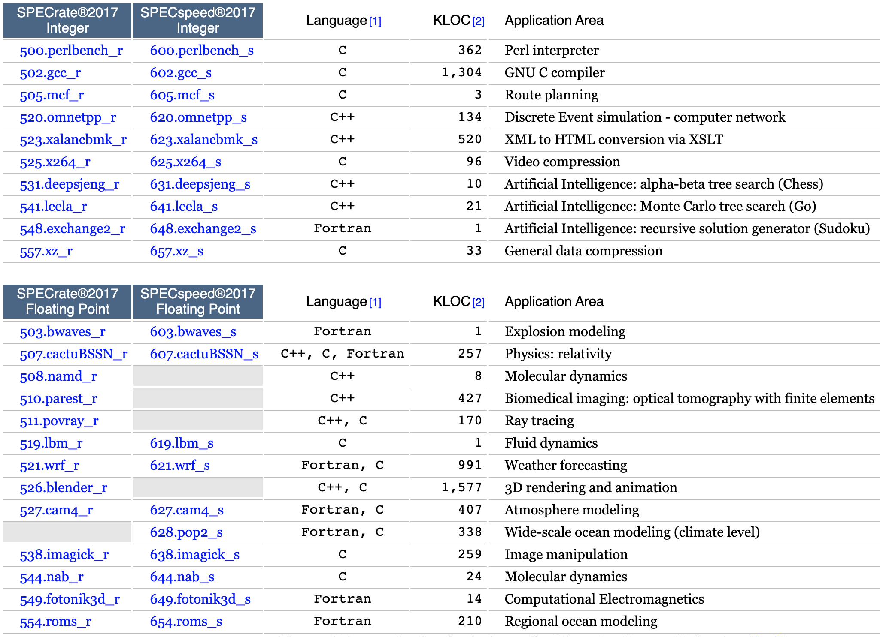
SPEC 2017
Kilo Lines of Code
throughput
time
Integers
Floating Point

Slide 18
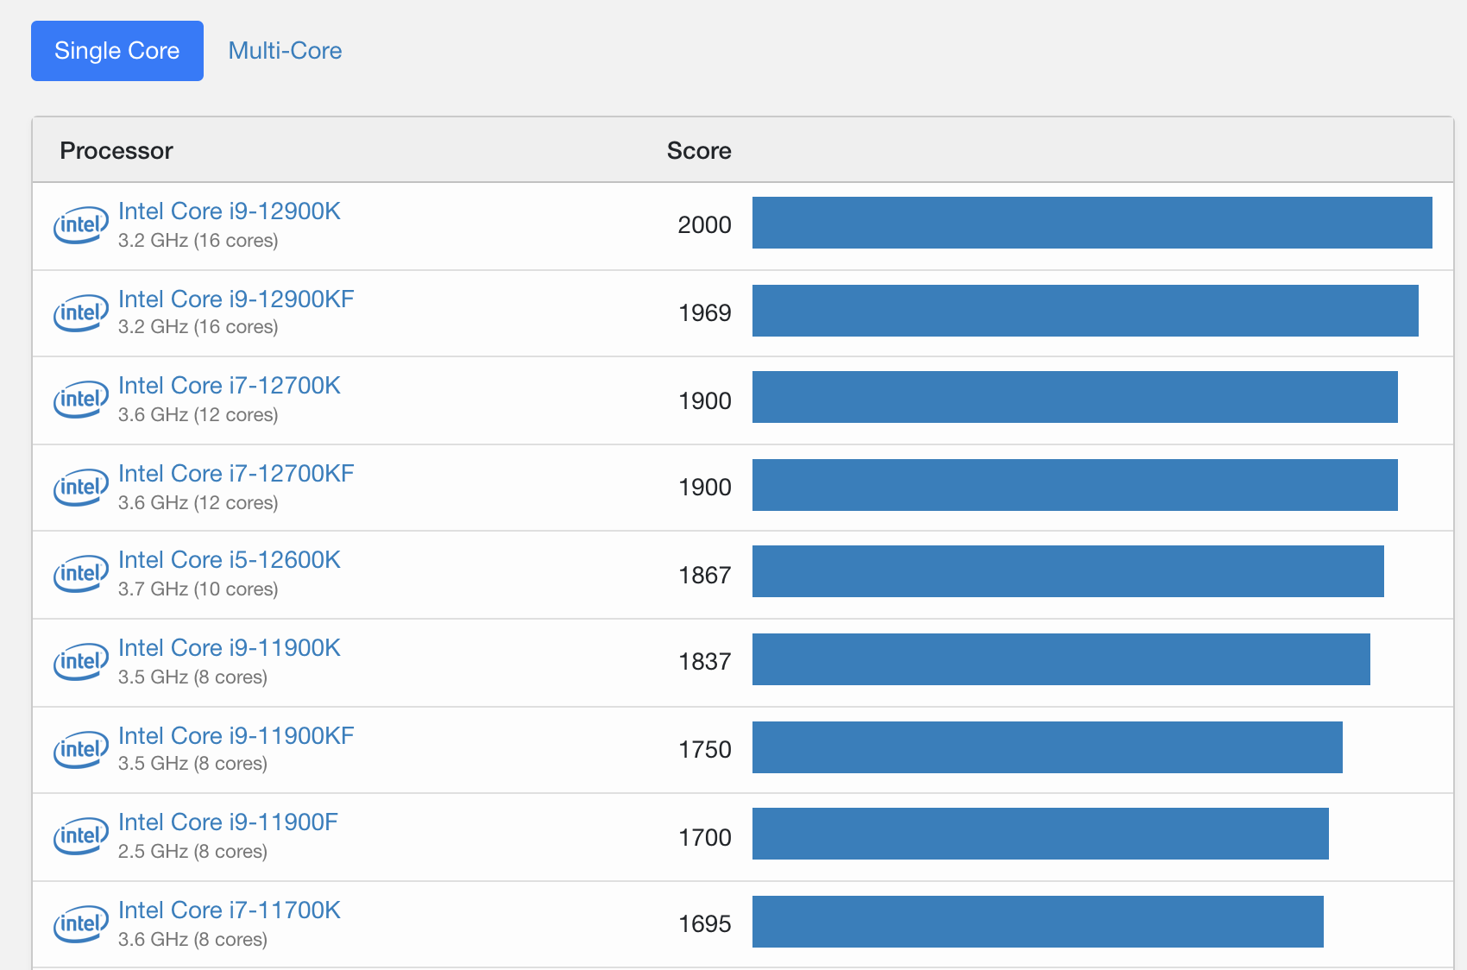
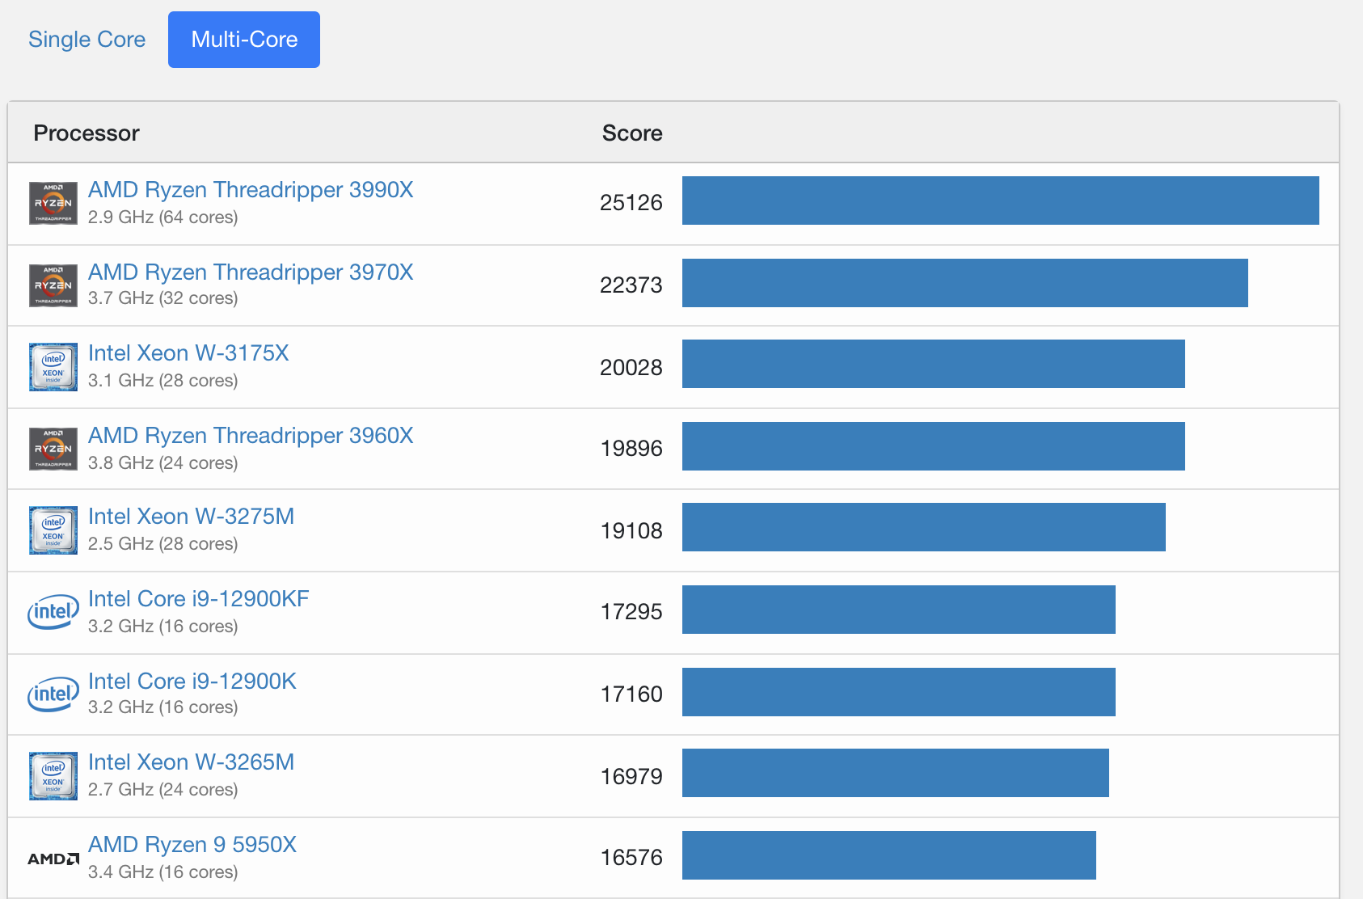
Other Popular Benchmarks
Several others popular
industry uses SPEC
but ordinary consumers use others
more representative of the work they do!
e.g., gaming, Photoshop/Aperture, copying huge files, multimedia coding/decoding, etc.
Geekbench is quite popular!

Slide 19
Fallacies and pitfalls
The improvement of one aspect of a computer to increase overall performance by an amount proportional to the size of the improvement.
Computers at low utilization use little power
Designing for performance and designing for energy efficiency are unrelated goals
Using a subset of the performance equation is a better performance metric
W
R
O
N
G

Slide 20
Amdahl’s Law
Possibly the most important law regarding computer performance:
Principle: Make the common case fast!
Eventually, performance gains will be limited by what cannot be improved
e.g., you can raise the highway speed limit, but the city speed limit stays the same
Gene Amdahl (1973)
Notes:
gives the theoretical speedup in latency of the execution of a task at fixed workload that can be expected of a system whose resources are improved.

Slide 21
Amdahl’s Law: Example
Suppose a program runs in 100 seconds on a machine, where multiplies are executed 80% of the time.
How much do we need to improve the speed of multiplication if we want the program to run 4 times faster?
How about making it 5 times faster?
25 = 80/r + 20 r = 16x
20 = 80/r + 20 r = ?

Slide 22
Example
Suppose we enhance a machine making all floating-point instructions run FIVE times faster.
If the execution time of some benchmark before the floating-point enhancement is 10 seconds, what will the speedup be if only half of the 10 seconds is spent executing floating-point instructions?
We are looking for a benchmark to show off the new floating-point unit described above, and want the overall benchmark to show at least a speedup of 3.
What percentage of the execution time would floating-point instructions have to account for in this program in order to yield our desired speedup on this benchmark?
5/5 + 5 = 6 Relative Perf = 10/6 = 1.67 x
10/3 = f/5 + (10 – f) = 10 – 4f/5 f = 83.33

Slide 23
Power Consumption
Power = Energy consumed per unit time
Two contributors to power consumption
Dynamic power
power consumed when doing actual work
called dynamic because components and wires are switching between ‘0’ and ‘1’
Static or ‘leakage’ power
power consumed even when everything is idle or ‘static’
due to some small amount of ‘leakage’ current that still flows

Slide 24
Dynamic Power Consumption
Energy consumed due to switching activity:
All wires and transistor gates have capacitance
Energy required to charge a capacitance, C, to V_{DD} is CV_{DD}²
Circuit running at frequency f: transistors switch (from 1 to 0 or vice versa) at that frequency
Capacitor is charged 0.5f times per second
P_{dynamic} = ½CV_{DD}²f
C is the total capacitance of circuit (“capacitive load”)
V_{DD} is the supply voltage
f is the switching frequency

Slide 25
Static Power Consumption
Power consumed when no gates are switching
Caused by the quiescent supply current, I_{DD} (also called the leakage current)
P_{static} or P_{leakage} = I_{DD}V_{DD}
V_{DD} is the supply voltage
I_{DD} is the leakage current

Slide 26
Power Consumption Example
Estimate the power consumption of a wireless handheld computer
V_{DD} = 1.2 V
C = 20 nF
f = 1 GHz
I_{DD} = 20 mA
P = ½CV_{DD}²f + I_{DD}V_{DD}
= ½(20 nF)(1.2 V)²(1 GHz) + (20 mA)(1.2 V)
= 14.4 W + 24 mW
= 14.424 W

Slide 27
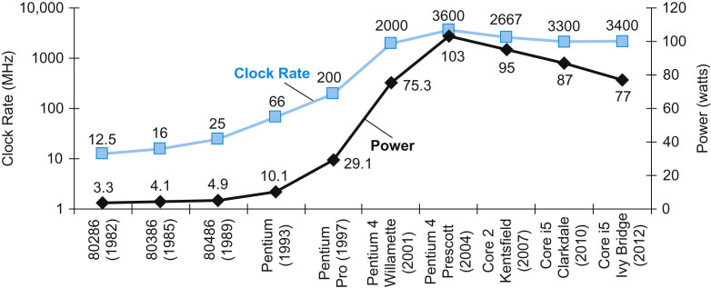
Power Trends
In CMOS IC technology
×30
5V → 1V
×1000
Notes:
Both clock rate and power increased rapidly for decades, and then flattened off recently. The reason they grew together is that they are correlated, and the reason for their recent slowing is that we have run into the practical power limit for cooling commodity microprocessors.
With Pentium 4, Intel was aiming to reach clock rate of 10 GHz!

Slide 28
Reducing Power
How power reduction is achieved if we replace the old CPU wit a new one which has
85% of capacitive load of old CPU
15% voltage and 15% frequency reduction
The power wall
We cannot reduce voltage further
Threshold Voltage
near Leakage Limit

Slide 29
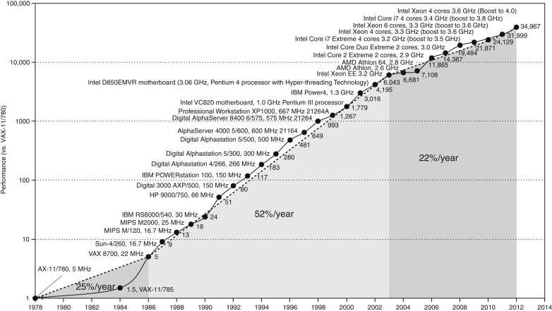
Moore’s Law: Uniprocessor Perf.
Constrained by power, instruction-level parallelism, memory latency

Slide 30
Fallacies and pitfalls
The improvement of one aspect of a computer to increase overall performance by an amount proportional to the size of the improvement.
Computers at low utilization use little power
Designing for performance and designing for energy efficiency are unrelated goals
Using a subset of the performance equation is a better performance metric
W
R
O
N
G

Slide 31
Fallacy: Low Power at Idle
AMD X4 power benchmark:
At 100% load: 295W (max power)
At 50% load: 246W (83% max power)
At 10% load: 180W (still consumes 61% of max power)
Google data center
Mostly operates at 10% - 50% load
At 100% load less than 1% of the time
Industry challenge: Design processors to make power proportional to load

Slide 32
Fallacies and pitfalls
The improvement of one aspect of a computer to increase overall performance by an amount proportional to the size of the improvement.
Computers at low utilization use little power
Designing for performance and designing for energy efficiency are unrelated goals
Using a subset of the performance equation is a better performance metric
W
R
O
N
G

Slide 33
Multiprocessors
“Multicore” microprocessors
More than one processor core per chip
Requires explicitly parallel programming
Hardware executes multiple instructions at once
Ideally, hidden from the programmer
Hard to do
Programming for performance
Load balancing
Optimizing communication and synchronization
But, newer OSs and libraries have been designed for this

Slide 34
Fallacies and pitfalls
The improvement of one aspect of a computer to increase overall performance by an amount proportional to the size of the improvement.
Computers at low utilization use little power
Designing for performance and designing for energy efficiency are unrelated goals
Using a subset of the performance equation is a better performance metric
W
R
O
N
G

Slide 35
A Useless Computer Performance Measure: MIPS
Millions of Instructions per Second
Frequency in MHz
Unfortunate coincidence:
This “MIPS” has nothing to do with the name of the MIPS processor we will be studying!
CPI (Average Clocks Per Instruction)
Pitfall: Cannot compare MIPS of two different processors if they run different sets of instructions!
➔ Meaningless Indicator of Processor Speed!

Slide 36
Remember
Performance is specific to a particular program
Total execution time is a consistent summary of performance
For a given architecture, the performance comes from:
increases in clock rate (without adverse CPI affects)
improvements in processor organization that lower CPI
compiler enhancements that lower CPI and/or instruction count
Improvements in one aspect of a machine’s performance do not bring linear improvement in the total performance
Power is a limiting factor
Use parallelism to improve performance

